Slide 1



MOOD BASED QUOTE GENERATOR WITH SPEECH
By Vandita Tripathi

Slide 2
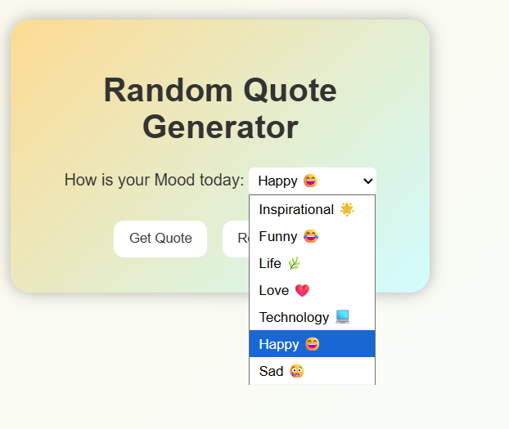

KEY FEATURES
  Web application built with HTML, CSS, and JavaScript with responsive design
  User can select a mood to filter quotes: Inspirational, Funny, Life, Love, Technology, Happy, Sad
  Supports reading the quote aloud using Speech Synthesis API
02

Slide 3
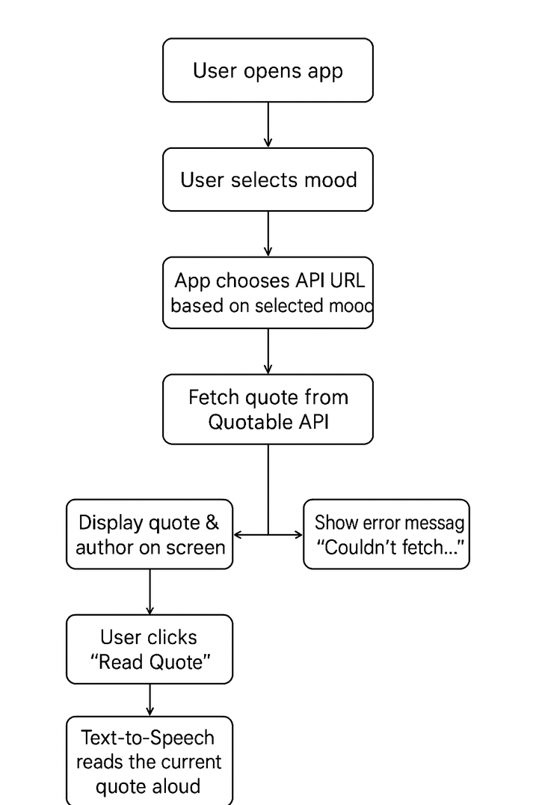
WIREFRAME
03

Slide 4
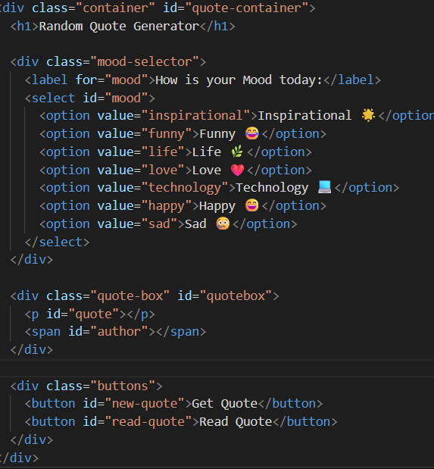
HTML STRUCTURE
  <!DOCTYPE html> and basic HTML structure
  select dropdown to choose mood
  div container for displaying quote & author
  Buttons: Get Quote & Read Quote
04

Slide 5
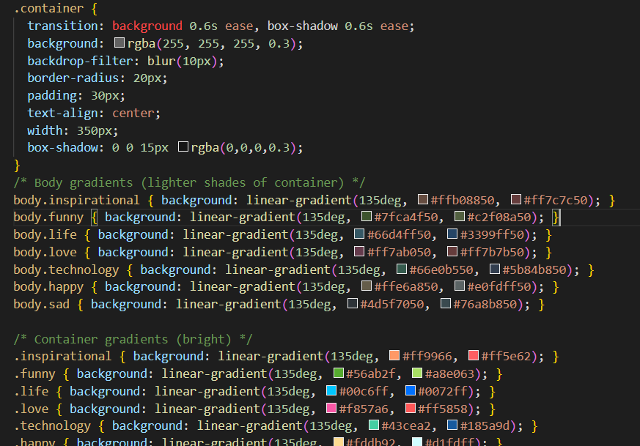
CSS STYLING
  Modern glassmorphism style for container
  Gradient backgrounds based on selected mood
  Smooth transitions for background and container
  Responsive font and layout
05

Slide 6
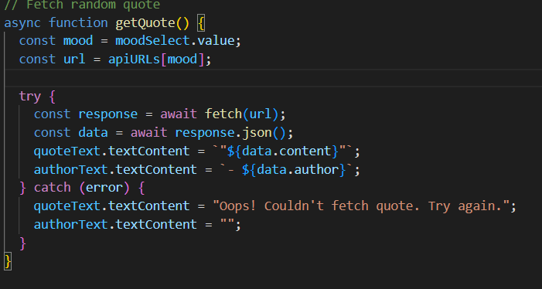
JAVASCRIPT – FETCH QUOTES
  Uses Quotable API
for random quotes
  Quotes filtered by
selected mood
  Async/await for API call
  Exceptions handling
06

Slide 7
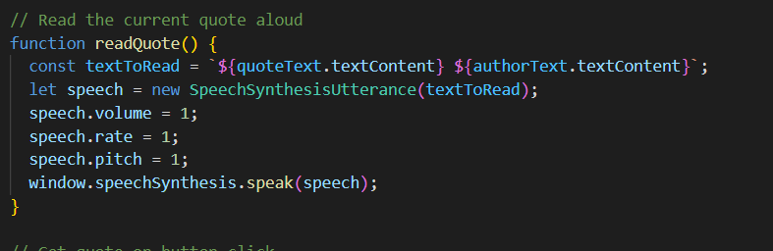
JAVASCRIPT – READ QUOTE
  Uses SpeechSynthesis API
  Reads current quote and author
07

Slide 8
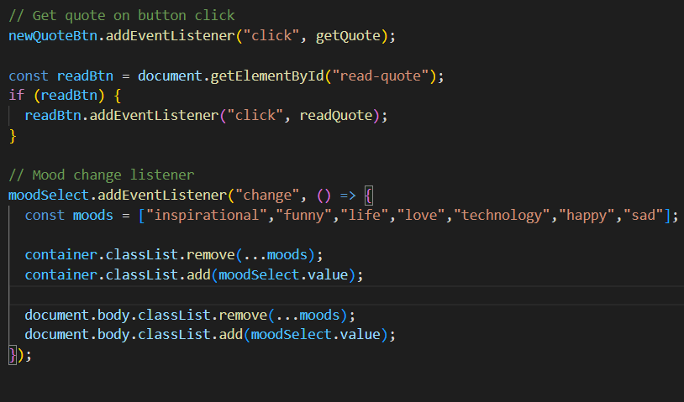
EVENT LISTENERS
User Interaction
  Button click to fetch a new quote
  Button click to read quote aloud
  Mood selection triggers background change
08

Slide 9
CONCLUSION
Conclusion & Learnings
  Simple yet interactive web application
  Hands-on experience with:
    HTML, CSS, JS
    Fetch API
    Speech Synthesis
    Dynamic styling with JS
  Can be extended with more moods or custom styling
09

Slide 10
THANK YOU
10

